Slide 1

An Introduction to Federated Learning and Its Analysis
 | Manjari Ganapathy Dept. of Computer Science University of Nevada, Las Vegas
Advisor and Chair: | Dr. Mingon Kang
Committee Members: | Dr. Kazem Taghva
 | Dr. Fatma Nasoz
 | Dr. Jeehee Lee

Slide 2
Goal of This Thesis
Present an overall review of Federated Learning
Analyze how model topologies impact Federated Learning with different data distributions

Slide 3
Agenda
Introduction
Applications
Literature Reviews
Network Topology
Results

Slide 4
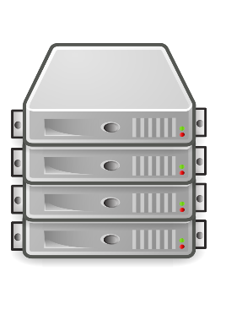
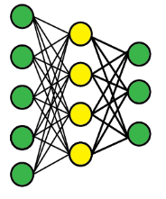
Conventional Machine Learning
Client 1
Data
Data Source 1
Data
Client 2
Training data
Model
Data
Data Source 2
Central storage
Client 3
Data Source 3

Slide 5
Constraints of Data
Data is sensitive (e.g., healthcare data)
Data-driven research
Regulations like GDPR and HIPAA
Investment

Slide 6
Data Breaches
Anthem Blue Cross : 78.8 million affected (2015)
Premara Blue Cross : 11+ million affected (2015)
Community Health Systems : 4.5 million affected (2014)
Advocate Health Care : 4 million affected (2013)
Tricare: 4.9 million affected (2011)
Reference: “Healthcare Data Breach Statistics”. Hipaa journal (2020). https://www.hipaajournal.com/
healthcare-data-breach-statistics

Slide 7

Federated Learning
Federated Learning (FL) is a learning paradigm, where multiple clients jointly train without exchange or centralize datasets
Model
Client 1
Model
Data Source 1
Model
Model
Model
Client 2
Data Source 2
Model
Model
Client 3
Server
Data Source 3

Slide 8
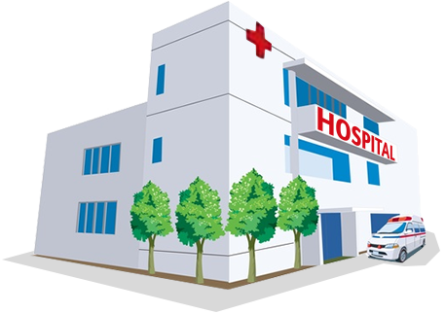
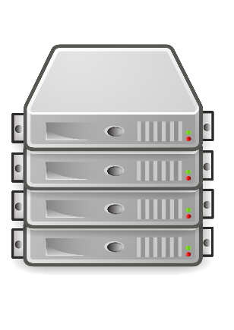
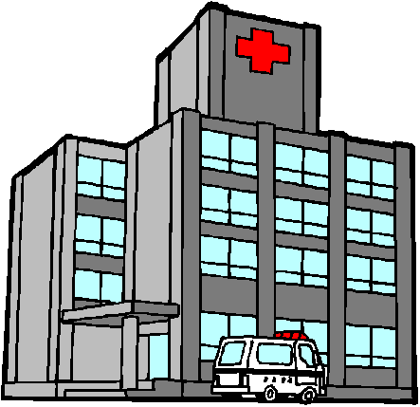

Hospital 1
Server
Hospital 2
Hospital 3
This Photo by Unknown Author is licensed under CC BY-SA

Slide 9



Hospital 1
Private Data
Server
Hospital 2
Private Data
Hospital 3
Private Data

Slide 10
Hospital 1
Private Data
Server
Hospital 2
Private Data
Base Model
Hospital 3
Private Data
This Photo by Unknown Author is licensed under CC BY-SA

Slide 11







$w:$Base Model
Hospital 1
$$w$$
Private Data
Server
Hospital 2
$$w$$
Private Data
Base Model
Hospital 3
$$w$$
Private Data
This Photo by Unknown Author is licensed under CC BY-SA

Slide 12
$w:$Base Model
Hospital 1
$$w$$
Private Data
Server
Hospital 2
$$w$$
Private Data
Base Model
Hospital 3
$$w$$
Private Data
This Photo by Unknown Author is licensed under CC BY-SA

Slide 13




$w^{i}$ : Model weight of hospital i
Hospital 1
$$w^{1}$$
Private Data
Server
Hospital 2
$$w^{2}$$
Private Data
Base Model
Hospital 3
$$w^{3}$$
Private Data
This Photo by Unknown Author is licensed under CC BY-SA

Slide 14

$w^{i}$ : Model weight of hospital i
Hospital 1
$$w^{1}$$
Private Data
Server
Hospital 2
$$w^{2}$$
Private Data
Base Model
Hospital 3
$$w^{3}$$
Private Data
This Photo by Unknown Author is licensed under CC BY-SA

Slide 15
$w:$Base Model
Hospital 1
$$w$$
Private Data
Server
Hospital 2
$$w$$
Private Data
Base Model
Hospital 3
$$w$$
Private Data
This Photo by Unknown Author is licensed under CC BY-SA

Slide 16
The Promise of Federated Efforts
Addresses privacy and data governance challenges
No duplication of data from local clients to central pool
Potential of growing global dataset

Slide 17
Comparison of conventional ML and FL workflow
Collect data to central storage
*Centralized training
Deploy
Conventional Machine Learning Workflow
Distribute base model to clients (*Decentralized training)
Base model
Aggregated model
Federated Workflow
*Centralized training | Storing the data in a single central repository, central training
*Decentralized training | Training within clients

Slide 18
Applications of Federated Learning
Mobile devices
Next word prediction model in a virtual keyboard
McMahan et al. "Communication-efficient learning of deep networks from decentralized data." Artificial Intelligence and Statistics. PMLR, 2017.
Predict emoji from text
Ramaswamy et al. "Federated learning for emoji prediction in a mobile keyboard." arXiv preprint arXiv:1906.04329 (2019).
Healthcare
Predict mortality and hospital stay time
D Mandl et al. “FADL:Federated-Autonomous Deep Learning for Distributed Electronic Health Record” In Proceedings of the Machine Learning for Health (ML4H) Workshop at NeurIPS 2018
MRI Analysis
Li, Xiaoxiao, et al. "Multi-site fMRI analysis using privacy-preserving federated learning and domain adaptation: ABIDE results." Medical Image Analysis 65 (2020): 101765.

Slide 19
Applications of Federated Learning
Industrial engineering
Autonomous driving
Ye et al. “Federated learning in vehicular edge computing: A selective model aggregation approach”. IEEE Access, 8:23920–23935, 2020.
Credit card fraud detection
Zheng et al. “Federated meta-learning for fraudulent credit card detection”. In Proceedings of the Twenty-Ninth International Joint Conference on Artificial Intelligence (IJCAI-20), 2020.

Slide 20
Challenges of FL
Privacy and Security
Poisson attacks
Data heterogeneity
Non-IID data
Architecture
Different hardware configurations for clients
Communication Cost
Upload and download model updates to/from server

Slide 21
Common Research Questions in FL
What are the methods to improve the quality of FL training algorithm, and training method?
What are the methods to improve the data privacy protection mechanism?
Can FL achieve similar learning performance to centralized setting?

Slide 22
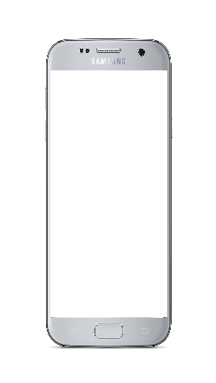





The Dawn of Federated Learning
Advantages of On-device
Inference
Improved latency
Better battery life
Privacy advantage
Better offline experience
Less data transfer
Prediction
Prediction
Request
Request
Training data
Model
Server
Client
Server
On-device inference
[McMahan et al, 2017]
Reference: McMahan et al. "Communication-efficient learning of deep networks from decentralized data." Artificial Intelligence and Statistics. PMLR, 2017

Slide 23
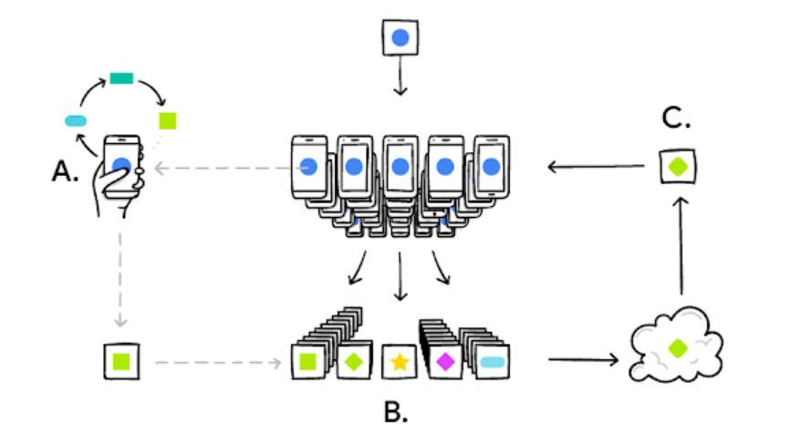
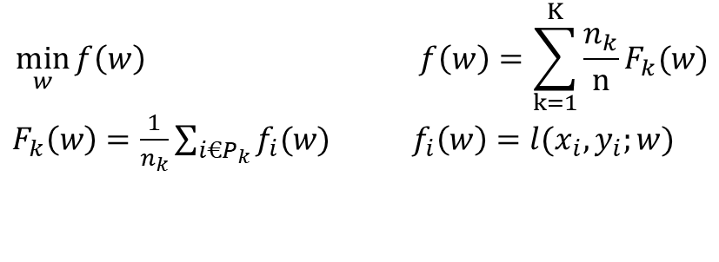
$$\min_{w}{f\left(w\right) } f\left(w\right)=\sum_{k=1}^{K}{\frac{n_{k}}{n}F_{k}(w)}$$
${ F}_{k}\left(w\right)=\frac{1}{n_{k}}\sum_{i€P_{k}}{f_{i}(w)}$ $f_{i}\left(w\right)=l(x_{i},y_{i};w)$
Reference: https://ai.googleblog.com/2017/04/federated-learning-collaborative.html

Slide 24
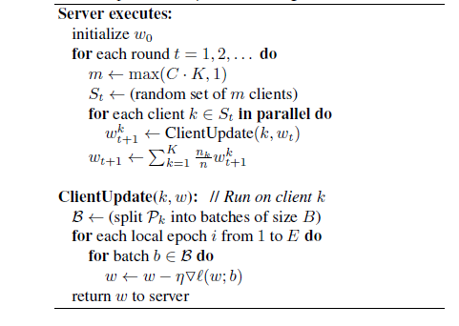
Fed-Averaging Algorithm
Reference: McMahan et al. "Communication-efficient learning of deep networks from decentralized data." Artificial Intelligence and Statistics. PMLR, 2017

Slide 25
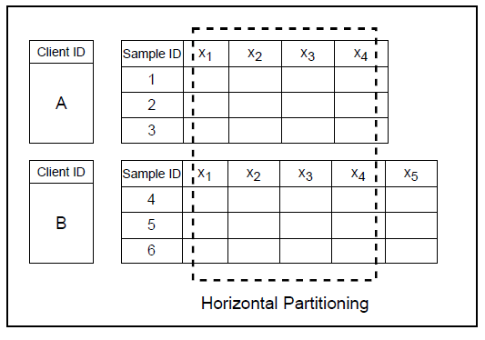
Categorization of FL Based on Data Distribution
Horizontal FL : or sample-based FL is a case where all the participating clients share the same feature space but with different sample ID space
More about categorization : Yang, Qiang, et al. "Federated machine learning: Concept and applications." ACM Transactions on Intelligent Systems and Technology (TIST) 10.2 (2019): 1-19.

Slide 26
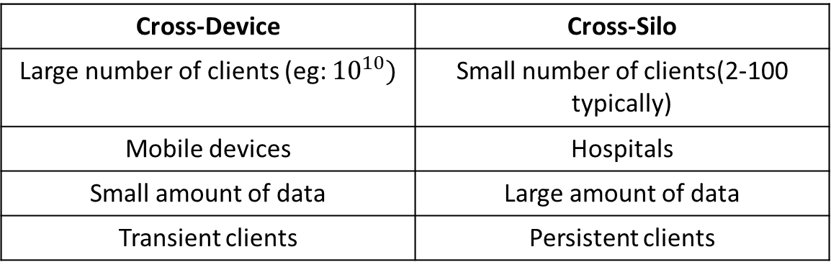
Cross-Silo and Cross-Device FL
Cross-Device | Cross-Silo
Large number of clients (eg: ${10}^{10})$ | Small number of clients(2-100 typically)
Mobile devices | Hospitals
Small amount of data | Large amount of data
Transient clients | Persistent clients

Slide 27
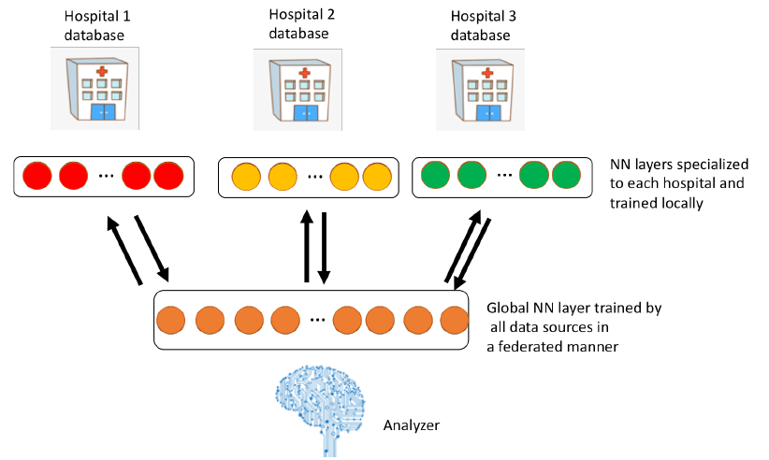
Literature Reviews in Horizontal FL
Federated Autonomous Deep Learning (FADL)
It has two stages. The first layer of the network is trained in a federated way and deeper layers of the network are trained locally to specialize in each client
Reference: D Mandl et al. “FADL:Federated-Autonomous Deep Learning for Distributed Electronic Health Record” In Proceedings of the Machine Learning for Health (ML4H) Workshop at NeurIPS 2018.

Slide 28
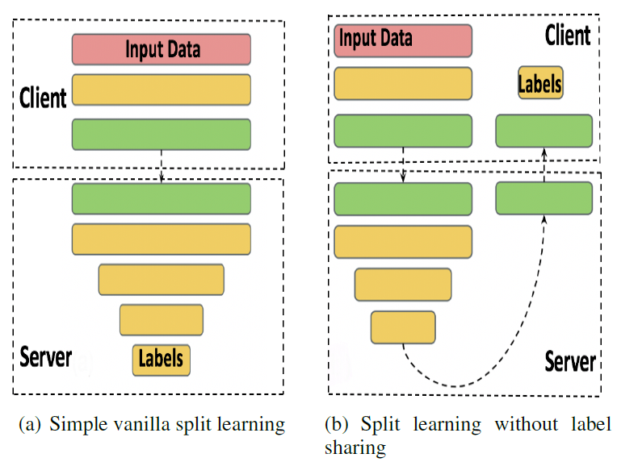
Literature Reviews in Horizontal FL
Split Learning
The learning task is divided and completed by two entities client and server
Reference: Vepakomma et al. “Split learning for health: Distributed deep learning without sharing raw patient data” In Proceedings of the 32nd Conference on Neural Information Processing Systems, Montreal, Canada, 2018.

Slide 29
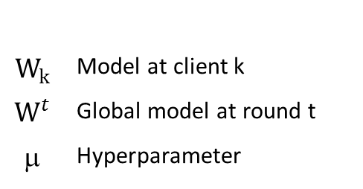

Literature Reviews in Horizontal FL
FedProx - FL with proximal term
Allows variable amount of work for each client to handle stragglers
Modifies the local subproblem by introducing a proximal term to the local objective function
${min W_{k} F}_{k}$($W_{k},X_{k})+\frac{μ}{2}{|\left|W_{k}−W^{t}\right||}^{2}$
$$W_{k}$$ | Model at client k
$$W^{t}$$ | Global model at round t
μ | Hyperparameter
Proximal term
Reference: Li et al. “Federated Optimization in Heterogeneous Networks” In Proceedings of the 3rd MLSys Conference, Austin, TX, USA, 2020

Slide 30
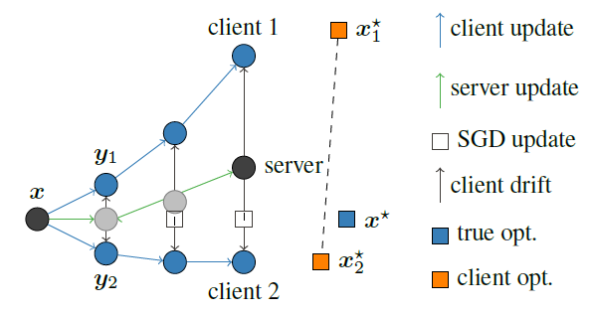
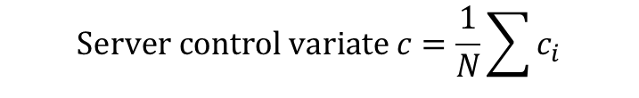

Literature Reviews in Horizontal FL
Scaffold
Stochastic Controlled Averaging algorithm (SCAFFOLD) which corrects for the client drift
$w_{i}w_{i}−η$($g_{i}\left(w_{i}\right)+c−c_{i}) ,$
$$Server control variate c=\frac{1}{N}\sum{c_{i}}$$
Reference: Karimireddy et al. "SCAFFOLD: Stochastic controlled averaging for federated learning." International Conference on Machine Learning. PMLR, 2020.

Slide 31
Network Topology
Arrangement of clients across the network
Different network topology may vary in
Distribution of model and aggregation of model
# communication links
System design cost
FL in star topology
FL in ring topology
FL in hybrid topology

Slide 32
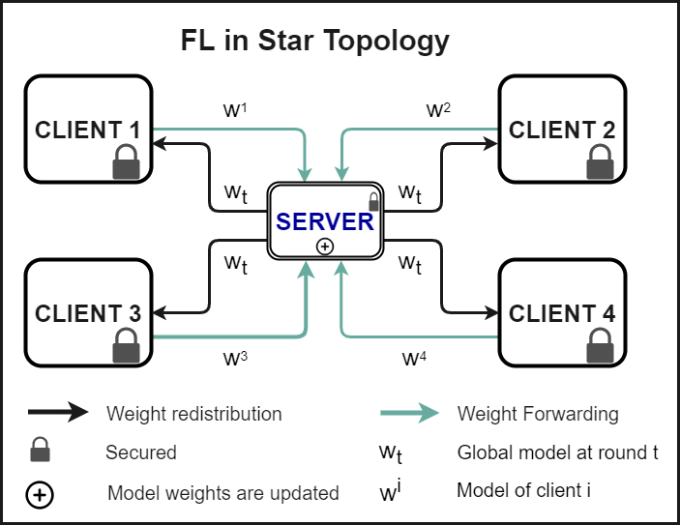

Network Topology
FL in star topology
Client and Server
$W_{t+1}=\frac{\sum_{i=1}^{K}{{W_{t}}^{i}.n_{i}}}{N}$,
${w_{t}}^{i} :Model of i ith$
client at round t
$n_{i} :\# samples in client i$
8 communication links
Reference: McMahan et al. "Communication-efficient learning of deep networks from decentralized data." Artificial Intelligence and Statistics. PMLR, 2017.

Slide 33
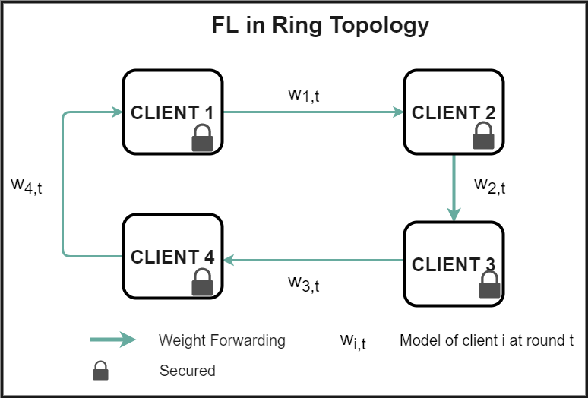
Network Topology
FL in ring topology
Peer to peer learning
No server
4 communication links
Reference: Balachandar et al. "Accounting for data variability in multi-institutional distributed deep learning for medical imaging." Journal of the American Medical Informatics Association 27.5 (2020): 700-708.

Slide 34
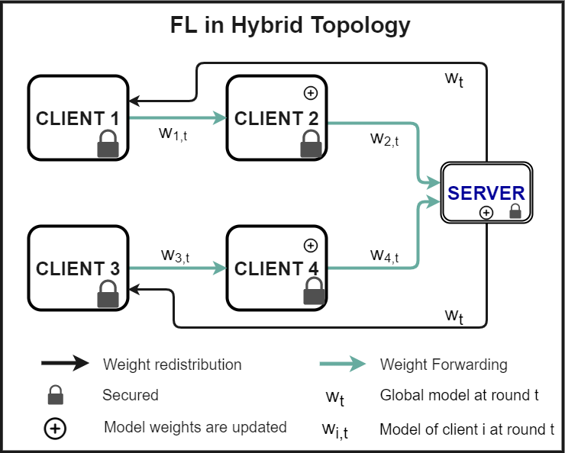

Network Topology
FL in hybrid topology
Both client and server
$W_{t+1}=\frac{\sum_{g=1}^{G}{{w^{g}}_{i,t}(n^{g})}}{N}$,
${w_{i,t}}^{g}$: Last i^{th} client’s model
in round t of group g
$n^{g}$: # samples in group g
N: Total # samples of all clients
6 communication links

Slide 35
Experiments
FL in star topology, FL in ring topology , FL in hybrid topology using MNIST dataset for IID and Non-IID data
3 cases for Non-IID
Label variability
Sample size variability
Both label and sample size variability

Slide 36
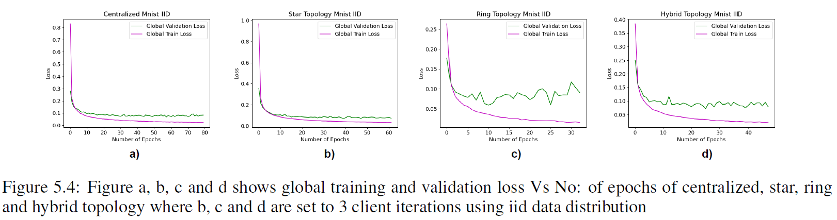
Results

Slide 37
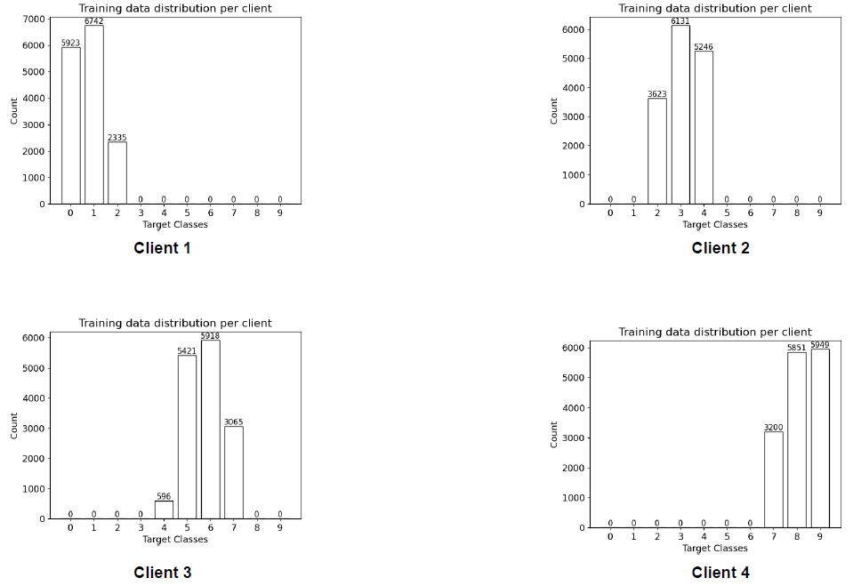
Label Variability

Slide 38
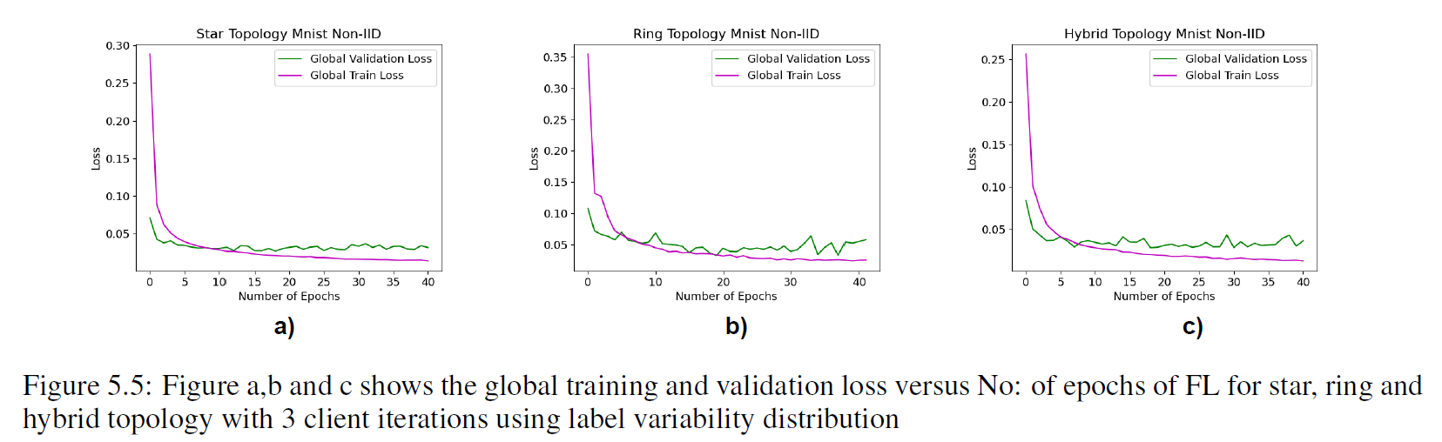
Results

Slide 39
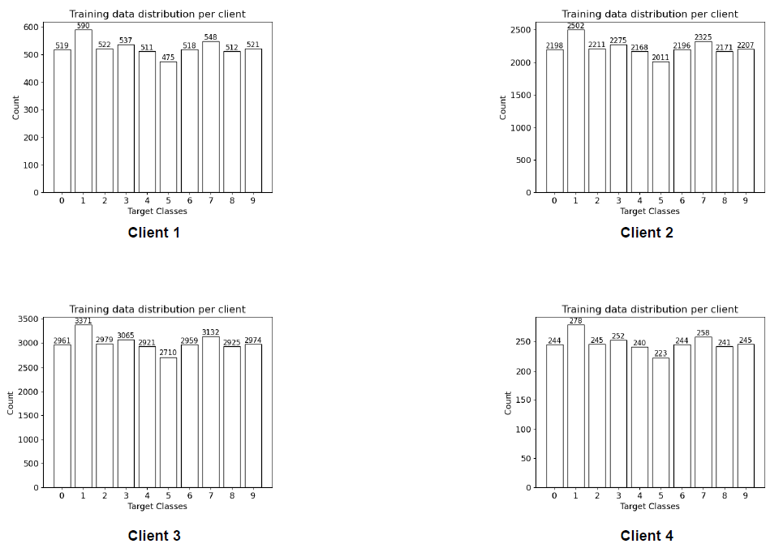
Sample Size Variability

Slide 40
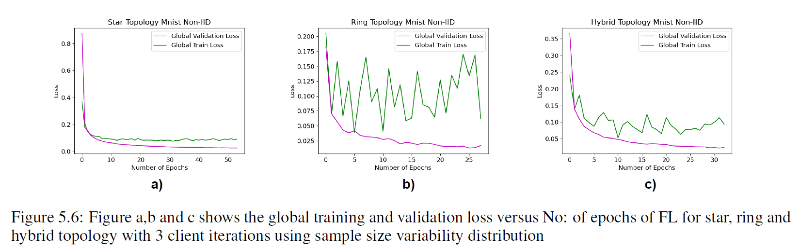
Results

Slide 41
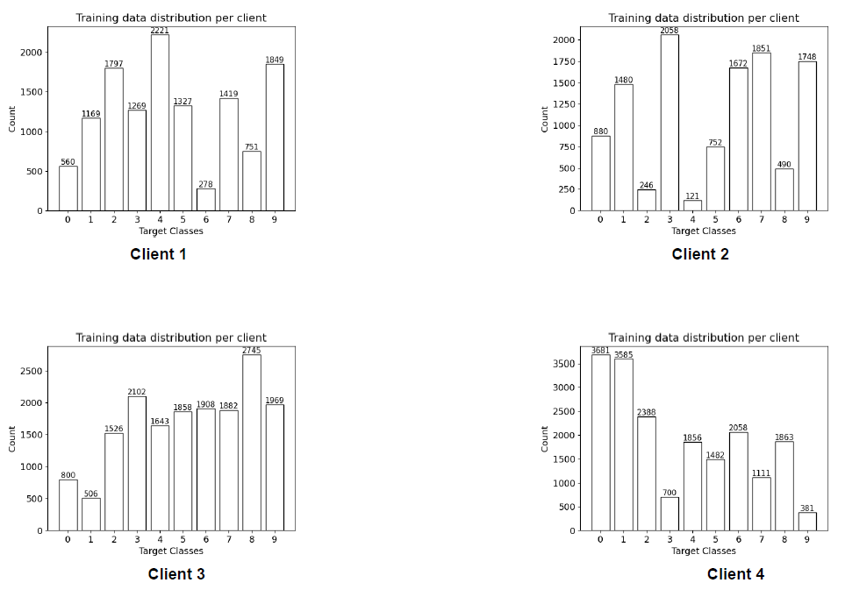
Label and Sample Size Variability

Slide 42
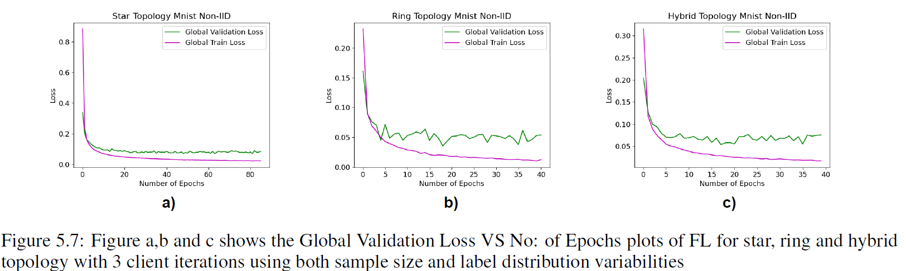
Results

Slide 43
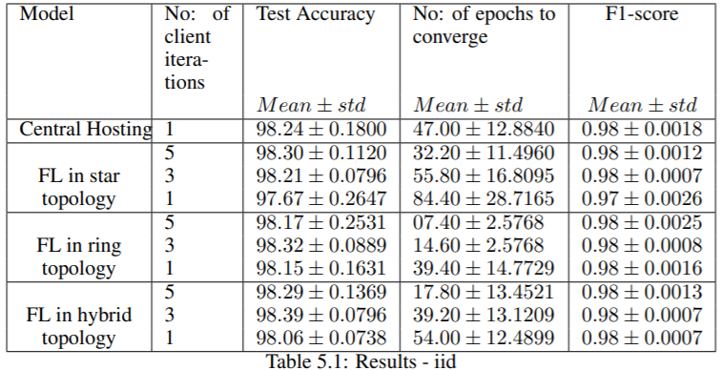
Results

Slide 44
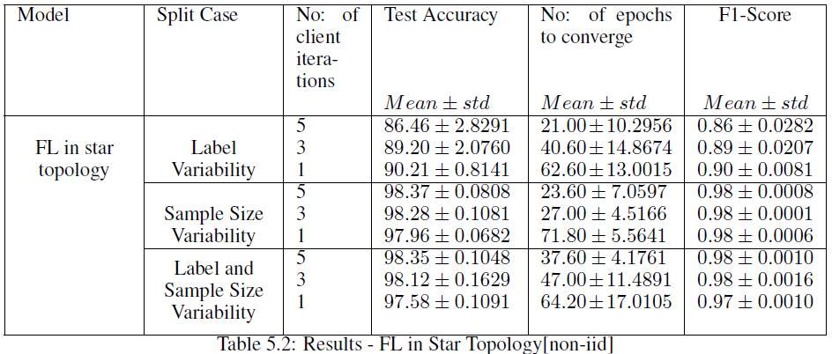
Results

Slide 45
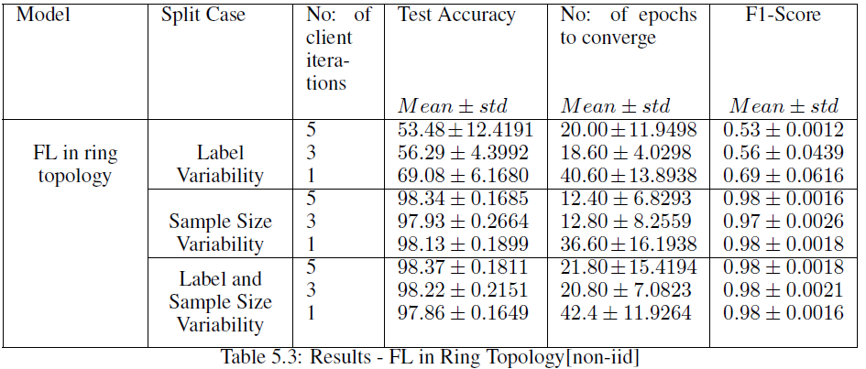
Results

Slide 46
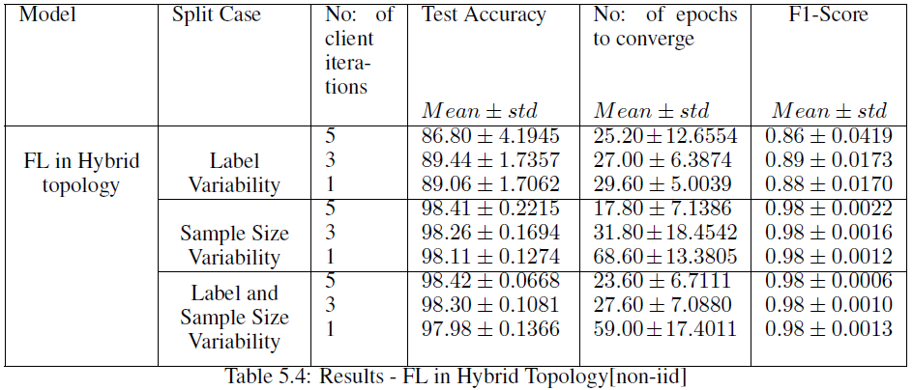
Results

Slide 47
IID Data
 | Centralized | FL in Star | FL in Ring | FL in Hybrid
Privacy preserved | No | Yes | Yes | Yes
Clients and Server | No | Yes | No | Yes
Test Accuracy ( 1 local epoch) | 98.24% | 97.67% | * 98.15% | 98.06%
Average # epoch convergence with 1 local epoch | 47 | 84.40 | 39.40 | 54.00
# Communication links for 1 round | 0 | 8 | 4 | 6
Best privacy preserving model (w.r.t accuracy, # communication links) [ranking] |  | Option 3 | Option 1 | Option 2
* Shows the highest test accuracy with least no: of epochs to converge w.r.t centralized setting

Slide 48
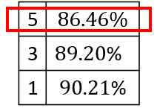
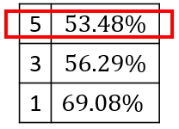
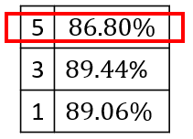
Non-IID Data
 | Centralized | FL in Star | FL in Ring | FL in Hybrid
Privacy preserved | No | Yes | Yes | Yes
Clients and Server | No | Yes | No | Yes
Test accuracy with 5, 3, 1 local epochs for highly Non-IID data | 98.24%
# Communication links for 1 round | 0 | 8 | 4 | 6
Best privacy preserving model (w.r.t accuracy, # communication links) [ranking] |  | Option 2 | Option 3 | Option 1
*
*
*
* The lowest test accuracy obtained with highest number (5) of local epochs in Non-IID distribution

Slide 49
Conclusion
In IID data, ring topology quickly converged and test accuracy of all model topologies were closer to the centralized setting
Ring topology poorly performed with highly Non-IID data
Hybrid topology performed equivalent to star topology in Non-IID data with an advantage of using lesser number of communication links than star topology
For extreme Non-IID data, the performance was less with too much local training for all model topologies
For lesser number of local epochs in client side, more epochs were required to converge for all model topologies

Slide 50
Thank You

